Slide 1
HEALTH BUDDY
PIP2001 Capstone Project
Review-1
Batch Number:CSE133
Roll Number | Student Name
20211CSE0531 | Tilakraj Ratnanj Revankar
20211CSE0532 | Siddhant Chavan
20211CSE0537 | Anisha Kumari
20211CSE0547 | Poorvika P
Under the Supervision of,
Dr. Shanmugarathinam
Associate Professor
School of Computer Science and Engineering
Presidency University
Name of the Program: CSE
Name of the HoD: Dr.Asif Mohammed H.B
Name of the Program Project Coordinator: Mr. Amarnath J.L
Name of the School Project Coordinators: Dr. Sampath A K / Dr. Abdul Khadar A / Mr. Md Ziaur Rahman

Slide 2
Content
Abstract
Literature Survey
Objectives
Existing Methods-Drawbacks
Proposed Method
Architecture Diagram
Modules
Hardware and Software Details
Time Line by Gantt Chart
References

Slide 3
Introduction
Organization: Cognizant
Category (Hardware / Software / Both) :Software
Problem Description: Our app allows you to enter the food you ate and with the help of a trained model it'll be able to predict the different types of vitamins and proteins and also calculate the calories consumed. After analyzing the data entered by the user for a couple of days, the app will tell you what vitamin you might be deficient of and the possible diseases you might get if you don't include that in your diet. It also keeps a track of the number of glasses of water you've had while also reminding you to hydrate yourself regularly. It also keeps a track of your physical activities and calories burned.
Difficulty Level: Moderate.

Slide 4
Literature Review
Machine Learning Applications for Nutrition Tracking: Machine learning (ML) is increasingly applied in health and nutrition tracking to enhance personalized diet recommendations. Systems like the one described by Espinosa et al. (2016) leverage mobile health apps to track dietary intake and provide real-time feedback. By utilizing data from food diaries and integrating information from wearable devices, these systems aim to offer users insights into their nutritional habits and deficiencies. The study highlights how ML models can analyze vast datasets to detect patterns in user behavior and provide proactive health recommendations .
Food Recommendation Systems Based on Health Conditions: Specific health conditions, such as diabetes or cardiovascular diseases, require tailored diet plans. For instance, the "Diabetic Buddy" system described by Borle et al. (2020) utilizes a personalized ML algorithm to regulate and track dietary intake for diabetic patients. It combines real-time blood sugar levels with food consumption data to offer recommendations that ensure glycemic control while meeting nutritional requirements. ML-based systems like these show promise in reducing user burden by automating the monitoring and suggesting alternatives based on individual health profiles .
Image-Based Nutrition Estimation: Estimating nutrition from food images is an exciting area of ML research. The method uses deep learning models trained on datasets containing food photos to predict the nutritional content of the meals. Studies like the one by Yanai et al. (2020) describe systems that extract information from multiple food image datasets, estimating calories, macronutrients, and vitamins from photos. This application could significantly improve dietary self-reporting, making it easier for individuals to monitor their intake without manually logging everything .
Vitamin Deficiency Detection and Diet Regulation: Vitamin deficiencies are prevalent worldwide, and ML systems are being developed to address this issue. A recent study discussed the use of machine learning algorithms to predict vitamin deficiencies and recommend suitable food items to mitigate the deficiency. The system analyzed user data such as age, weight, dietary preferences, and food intake to identify potential deficiencies. Once identified, it recommended meals rich in the missing nutrients. This ML-based approach can help address gaps in dietary intake and promote better health outcomes .

Slide 5
Existing method Drawback
Limited Personalization Issue: Many health apps provide generic advice, tips, and health tracking, but they lack deep personalization. They often fail to account for individual variations like medical history, lifestyle, genetic predispositions, or specific goals.
Privacy and Security Concerns Issue: Health apps collect sensitive personal health information, and inadequate security measures can put this data at risk. Poor encryption, lack of user control over data, or breaches of confidentiality are common issues.
User Engagement and Retention Issue: Many health apps struggle to retain users over time. Users may find the app difficult to use, unengaging, or not motivating enough to continue their health goals.
Overwhelming or Complex UI/UX Issue: Some health apps have a cluttered interface, complicated navigation, or too many features that overwhelm the user.
Lack of Interactivity with Healthcare Providers Issue: Some health apps focus solely on self-care and fail to create a bridge between users and healthcare professionals.
Limited Adaptability for Chronic or Specific Conditions Issue: Apps often fail to provide adequate support for users with chronic conditions or specific health concerns, such as diabetes, hypertension, or mental health issues.
No Integration with Behavioral Science or Habit Formation Issue: Many health apps don’t leverage behavioral science to help users build long-lasting habits. They lack features that support gradual behavior change, positive reinforcement, or goal-setting.
Monetization and Accessibility Issue: Many apps rely on subscription models, ads, or in-app purchases that may limit accessibility for users who cannot afford them. Due to this, financial barrier can exclude certain groups from using the app, which goes against the goal of making health support accessible to all.

Slide 6
Proposed Method
1. Enhanced Personalization Approach: Utilize AI and machine learning to personalize recommendations based on individual user data, including medical history, lifestyle, age, gender, genetic predispositions, and specific health goals.
Features:
Custom health and fitness plans tailored to each user.
Adaptive algorithms that learn from user feedback and behaviors to fine-tune recommendations.
Ability to set personalized reminders for medication, exercise, or hydration based on user habits
2. Robust Privacy and Security Measures Approach: Implement state-of-the-art data encryption, anonymization, and compliance with regulations to protect user information.
Features:
Multi-factor authentication (MFA) for login and data access.
Transparent user control over data sharing preferences, with the ability to delete data permanently.
Regular security audits and updates to ensure the app remains secure against emerging threats.
3. Gamification and Engagement Strategies Approach: Use gamification techniques to make the app more engaging and encourage habit formation.
Features:
Interactive community features such as health-focused groups or social challenges.
Daily health tips, motivational content, and personalized push notifications to maintain user interest.

Slide 7
Proposed Method
4. Intuitive User Interface and User Experience (UI/UX) Approach: Design a user-friendly interface with simple navigation and visually appealing elements that make it easy to track health metrics.
Features:
Customizable dashboards where users can select what metrics to display.
Dark mode and accessibility options for users with visual impairments.
Minimalist design to avoid overwhelming users with too many features at once.
5. Behavioral Science-Based Habit Formation Approach: Leverage behavioral science principles to help users build sustainable health habits.
Features:
Gradual goal-setting and habit formation techniques based on the user's readiness and motivation.
Positive reinforcement with rewards for achieving incremental progress toward larger health goals.
Personalized habit-tracking tools to monitor daily behaviors such as nutrition, exercise, sleep, or mindfulness.

Slide 8
Objectives
Health Monitoring: Allow users to track various health metrics, such as physical activity, sleep patterns, heart rate, and other vital signs, to get insights into their overall health.
Mental Health Support: Provide resources for mental well-being, including meditation exercises, stress-relief activities, or guided breathing sessions to help manage anxiety, depression, or stress.
Personalized Recommendations: Offer tailored advice on diet, exercise, and lifestyle changes based on the user's health data, preferences, and goals.
Habit Tracking: Help users establish and maintain healthy habits, such as regular exercise, balanced eating, or quitting smoking, by tracking progress and sending reminders.
Community Support: Facilitate a social network or community feature where users can connect, share experiences, and motivate each other toward achieving their health goals.
Goal Setting and Progress Tracking: Enable users to set health goals and monitor their progress over time with visual aids like charts or progress bars.
Alerts and Reminders: Notify users about important health-related tasks, such as taking medication, upcoming appointments, or completing daily exercise goals.
Data Security and Privacy: Ensure that user health data is securely stored and protected, with options for users to control data sharing and privacy settings.

Slide 9
Methodology/Modules
Requirement Gathering and Planning
Define Objectives and Features: Clearly outline the app’s objectives and identify essential features.
Technical Feasibility: Evaluate technical requirements and constraints and decide on platforms.
2. User-Centric Design
User Experience Design: Create a user-friendly interface with intuitive navigation and clear visual hierarchy. Ensure the design supports user needs and preferences.
Wireframes and Prototyping: Develop wireframes to map out the user flow and interactions, followed by prototypes to simulate the app experience.
User Testing: Conduct usability tests with a sample group of users to gather feedback and make necessary adjustments to the design.
3. Development
Backend Development: Set up server-side infrastructure, databases, and API integrations. Implement data storage solutions that ensure secure handling of health data.
Frontend Development: Build the user interface based on the design specifications, ensuring compatibility with different devices and screen sizes.
Feature Development: Implement core features such as health monitoring, notifications, habit tracking, and integration with wearable devices.

Slide 10
Methodology/Modules
4. Integration and Testing
Integration Testing: Ensure all components (frontend, backend, third-party services) work seamlessly together.
Quality Assurance (QA) Testing: Conduct thorough testing to identify and fix bugs. This includes functional testing (feature performance), usability testing, and performance testing (response times).
User Acceptance Testing (UAT): Involve a group of end users to test the app in real-life scenarios and provide feedback for final adjustments.
5. Deployment
App Store Submission: Publish the app on relevant app stores (Google Play, Apple App Store) following their guidelines.
Backend Deployment: Host the server-side components on a reliable cloud service (e.g., AWS, Azure) with scaling capabilities.
6. Maintenance and Updates
Regular Updates: Continuously improve the app based on user feedback, technological advancements, and emerging health trends.
Bug Fixes: Monitor for bugs or security issues and address them promptly through updates.
Feature Expansion: Roll out new features or integrations as the app evolves to enhance user experience and maintain relevance.
7. Data Analysis and Optimization
User Behavior Analysis: Monitor app usage patterns to understand user engagement and identify areas for improvement.
Health Data Analysis: Utilize anonymized health data (with user consent) to generate insights, such as trends in user behavior or popular health concerns.

Slide 11
Software components
Development Tools: IDEs/Editors: Visual Studio Code, Android Studio
Version Control: Git, GitHub/GitLab/Bitbucket
CI/CD: Jenkins, GitHub Actions, GitLab CI/CD.
Front-End Development: Frameworks/Libraries: React Native, Flutter, Kotlin (Android)
Back-End Development: Languages/Frameworks: Node.js, Spring Boot (Java), ASP.NET Core (C#)
Databases: Relational: MySQL
NoSQL: MongoDB.
Management Tools: MySQL Workbench, MongoDB Compass
Machine Learning & Data Analysis: Frameworks: TensorFlow, PyTorch
Libraries: Pandas, NumPy, Scikit-learn.
Cloud & Infrastructure: Providers: AWS, Google Cloud
Storage: Amazon S3, Google Cloud Storage.
Communication & Notification: Push Notifications: Firebase Cloud Messaging
APIs & Integration: Nutrition Databases: USDA Food Data Central, Nutritionix API

Slide 12
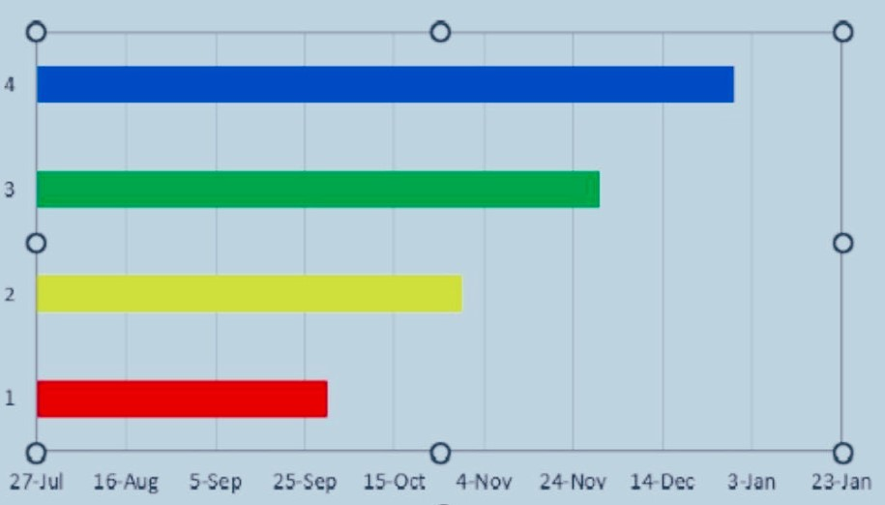
Timeline of Project

Slide 13
Expected Outcomes
1. User Health Monitoring & Insights:
Nutritional Analysis: Users will receive detailed breakdowns of the vitamins, proteins, and calories consumed from their meals.
Deficiency Detection: After a few days of tracking, the app will identify potential vitamin deficiencies and provide health warnings related to those deficiencies .
Disease Prevention: By informing users of potential deficiencies, the app may reduce risks of nutrition-related diseases
2. Personalized Recommendations:
Diet Suggestions: Based on detected deficiencies, the app will recommend foods rich in the missing nutrients
Hydration Reminders: Users will receive reminders to drink more water based on their intake trends.
Physical Activity Tracking: Insights on calories burned will allow users to understand their energy balance, motivating them to stay active.
3. Improved User Habits:
Behavioral Change: Continuous tracking and reminders should help users develop healthier habits, such as consistent hydration and nutrient-rich food choices.
4. User Retention & Engagement:
Daily Engagement: The app's reminders and feedback loops (hydration reminders, activity tracking, deficiency warnings) will encourage users to check in daily.
Habit Formation: With consistent tracking, users are likely to develop routines around hydration, physical activity, and balanced nutrition.
5. Data Insights for Future Enhancements:
User Health Trends: Aggregated data can reveal common deficiencies or health trends, helping improve app recommendations.
Feedback for Machine Learning: As more users input data, the machine learning models will refine predictions, improving accuracy for nutrient intake and deficiency detection.

Slide 14
Github Link
Github Link
https://github.com/CSE133/Capstone-project---Health-buddy

Slide 15
References
Research Papers:
https://mhealth.jmir.org/2016/3/e85/
https://www.researchgate.net/publication/364083577_Nutrition_information_estimation_from_food_photos_using_machine_learning_based_on_multiple_datasets
https://www.ncbi.nlm.nih.gov/pmc/articles/PMC5499922/
https://www.ncbi.nlm.nih.gov/pmc/articles/PMC9776646/
https://www.ijraset.com/research-paper/vitamin-deficiency-and-food-recommendation-system-using-ml
https://www.researchgate.net/publication/348403597_The_Diabetic_Buddy_A_Diet_Regulator_andTracking_System_for_Diabetics
https://www.ncbi.nlm.nih.gov/pmc/articles/PMC7551874/
https://www.sciencedirect.com/science/article/pii/B9780124095472143124
https://www.sciencedirect.com/science/article/pii/B9780124095472143148
https://www.sciencedirect.com/science/article/pii/B9780123848628000091
https://www.healthyfamiliesbc.ca/sites/hfbcprox-prod.health.gov.bc.ca/files/restaurant_info/guide-to-nutrient-analysis.pdf
Dataset:
https://www.kaggle.com/datasets/utsavdey1410/food-nutrition-dataset

Slide 16

Project work mapping with SDG
Good Health and well-Being

Slide 17
Thank You

